Slide 1
The Problem with functional labels/aspergers & alternatives

Slide 2
Origin of functional labels
Functional labels such as high or low do not refer to ability to do everyday tasks originally or survive but IQ
IQ is a messed up system that doesn’t take into account many types of intelligence, emotional or sensory differences, memory, education etc. It’s biased to those that feel motivated to do test etc many AA or ADHD under perform simply do to not being motivated when young (happy to provide resources), distracted, or sensory issues. ND also tend to have intelligence that outperforms NT in odd ways & our abilities tend to fluctuate more
Examples include autistics tend to outperform NT in Raven Intelligence test which is pictorial based and no time limit compared to standard Binet which NT outperform AA. One source on this: https://www.ncbi.nlm.nih.gov/pmc/articles/PMC4287210/
It’s then standardized scores in weird ways that assume a population distribution proven inaccurate
Than language developed was for white educated family in tests and so minorities perform lower. In fact IQ tests work better in regions they develop from UK test working better in UK than US in US
It doesn’t take into account many English dialects etc which can cause many racial problems or speech disorders or hearing when we talking about aspergers etc

Slide 3
High Vs Low Functioning (Problems)
This was based on idea “high functioning” autistics (and actually many ND or LGTBQ+ and even black and indigenous people “conversion” to being “civilized”) who were smarter could be converted and taught to be white NT cis straight or at least act that way
Low functioning were given upon and often institutionalized particularly BIPOC who scores were documented to purposefully lower
This system didn’t take into account support or environment they grow up in
Later we got rid of IQ testing instead guy who didn’t know you walked in often in under half an hour did assessment of your intelligence instead of IQ by looking at forms etc
High functioning denied services low was treated as object
Most countries got rid of functional labels in diagnosis and other moving away except insurances bc they just want money and want to deny services to some

Slide 4
Asperger’s another functional label
-I’m not even getting into how horrible he was
-These high-functioning labels were often synonymous with being labeled Asperger’s vs autistic
-Asperger’s meant you could “speak right English” (according to white folks etc so super biased) at young age or seemed to be intelligent but there was also no set definition almost only white cis men got it for a long time

Slide 5
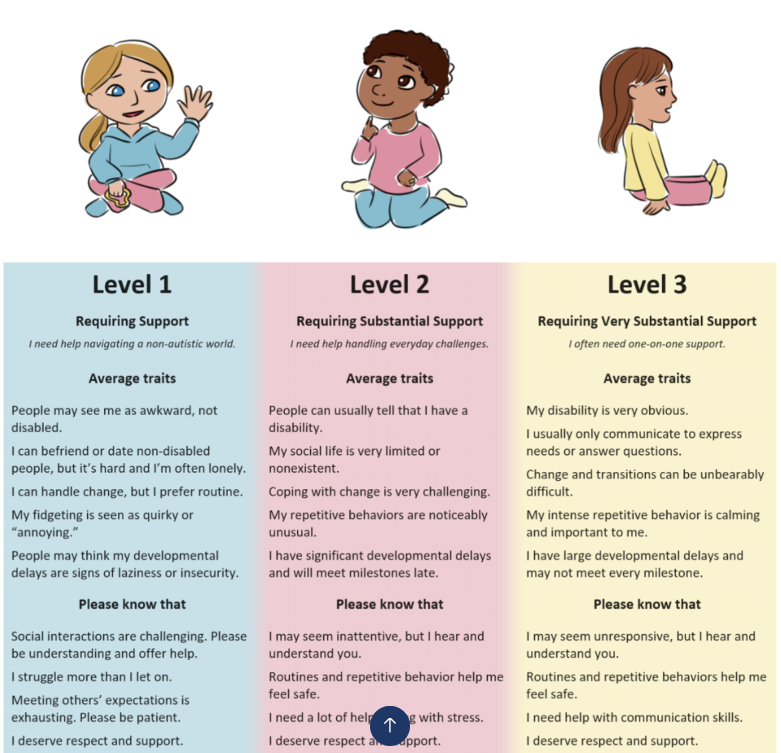
Autism “levels” (ex. Of problematic image on right)
Now we went to levels in many places. Levels are supposed to mean how much support you need. However they still biased as literally (attach image) you become “better” if you date and have NT and “normal” friends? What the fuck? I should date abliest etc people bc they better and more desirable? Eye contact means I need less
help? Repetitive no harm tasks means I need more help?
and so in literally it’s just about fitting in
And how well we fit in has nothing to do with happiness
Bad image from:
https://granite.pressbooks.pub/understanding-and-supporting-learners-with-disabilities/chapter/autism-spectrum-disorders/
(sorry can’t make text for it bc character limits)

Slide 6
Alternative
Any broad labels comes with biases which especially bad with functional as high ones or upper level seen as not needing help while low we give up on them being able to accomplish anything
These labels also divide our community
The alternative is simple, but longer
List specific needs issues abilities etc, and talents and skills
Every ND wildly different and that’s how we can be seen as whole and actually get help we need not some condescending help when not needed and be recognized for good stuff too

Slide 7
By VeAnxious_Au_Learner
Find other posts on: https://tinyurl.com/3eueneys
Patreon: http://patreon.com/user?u=86918513 Venmo: gad-licht-1
Link to even more stuff: https://linktr.ee/VEANXIOUS

